Slide 1
bio & sinovac 1
File created on: 2022-11-17 3:03:28

Slide 2
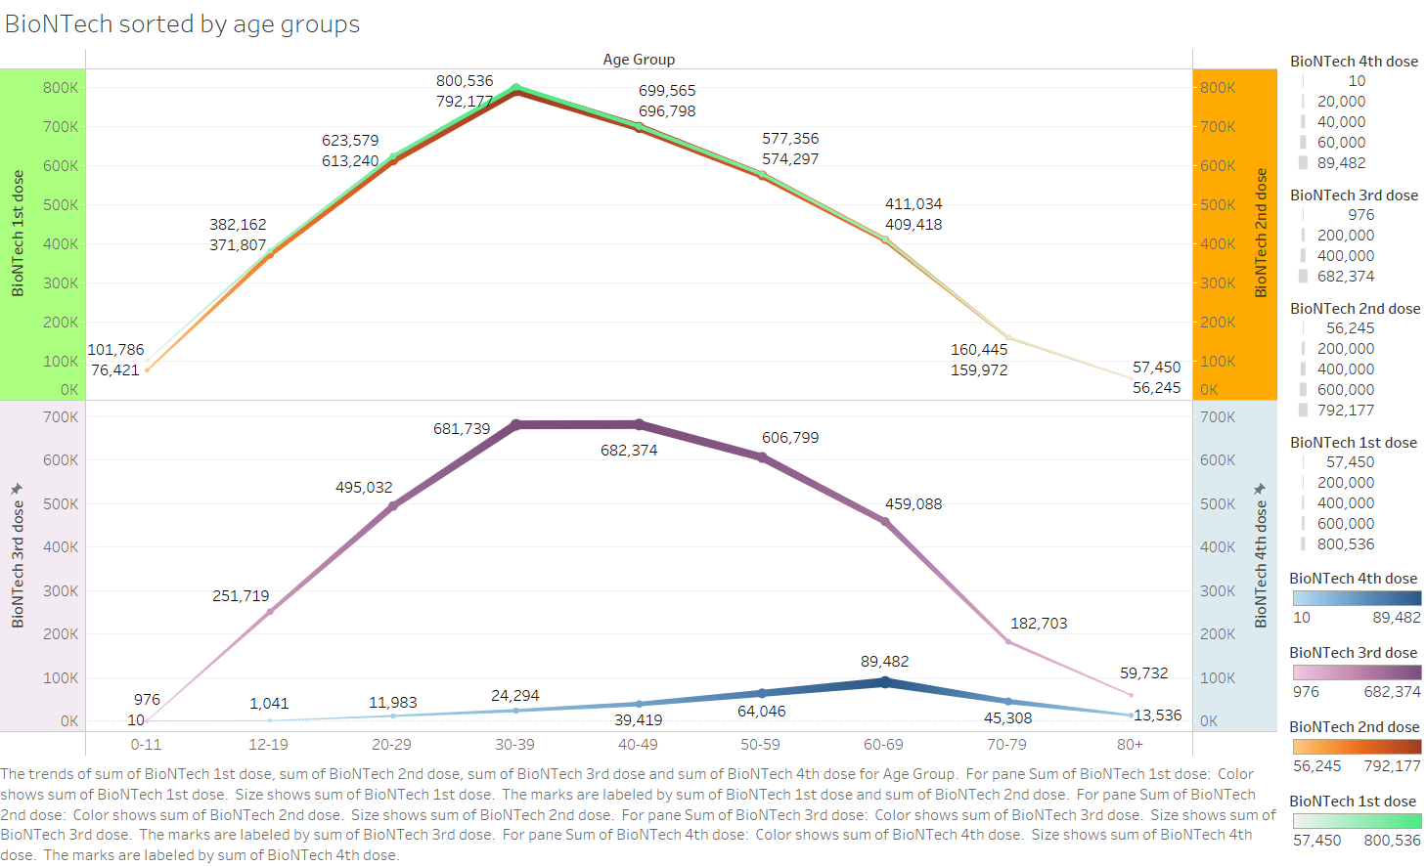

Slide 3
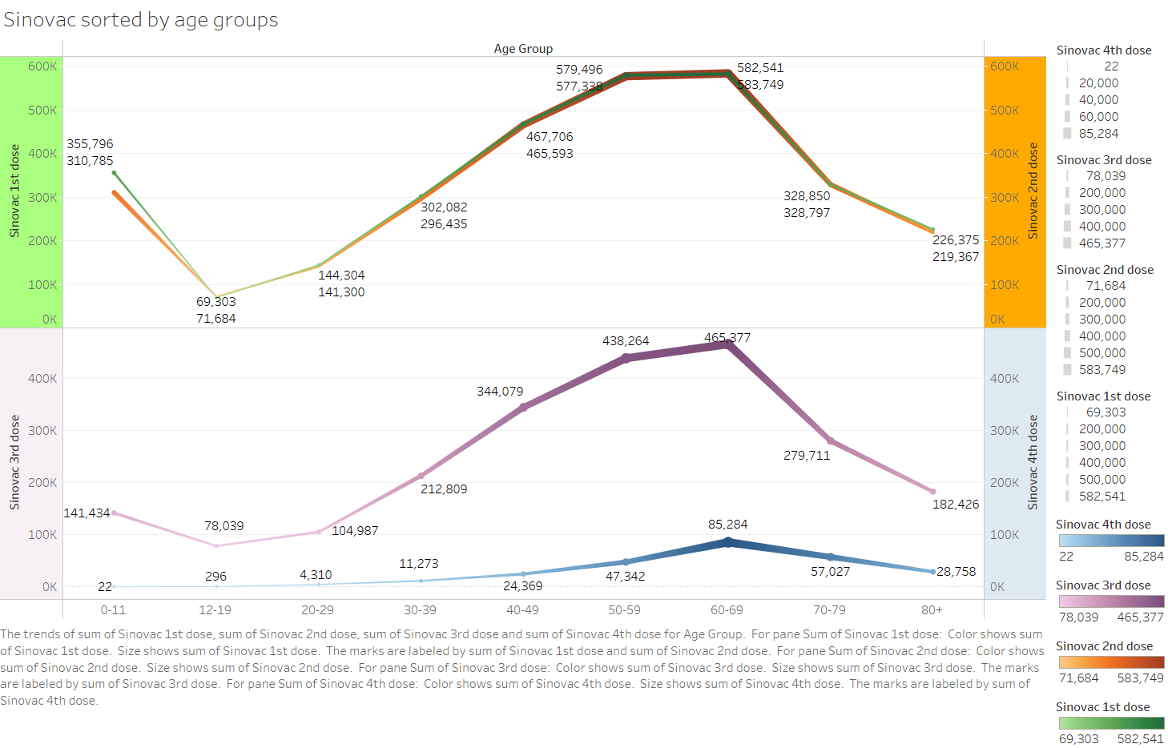

Slide 4
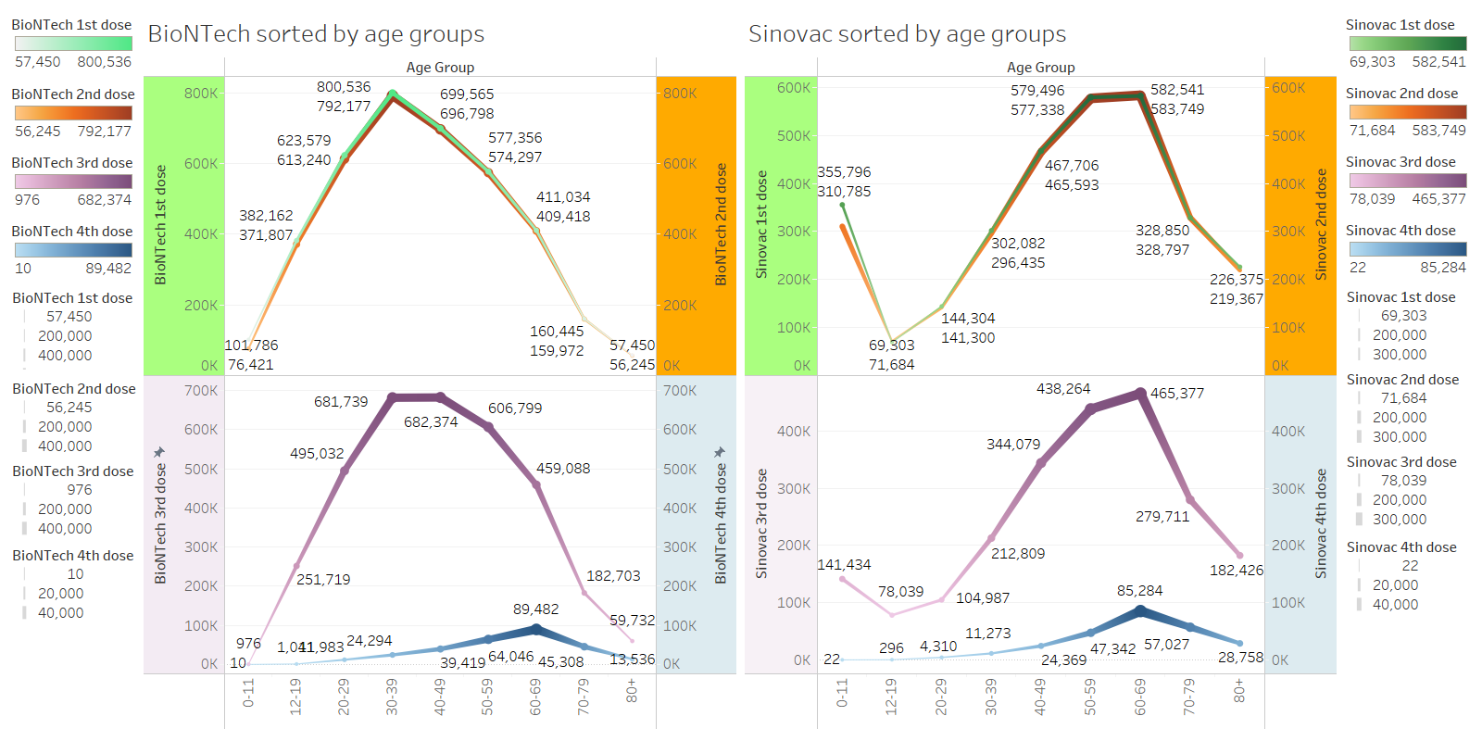

Slide 5
